Slide 1
Increasing the Sharon Select Board to 5
SelectBoard February 23, 2021

Slide 2
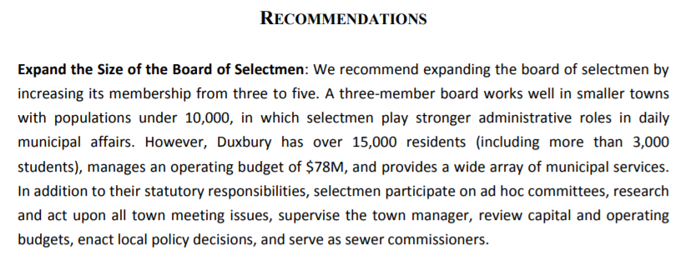
Duxbury, MA
https://www.mass.gov/doc/duxbury-government-study/download

Slide 3
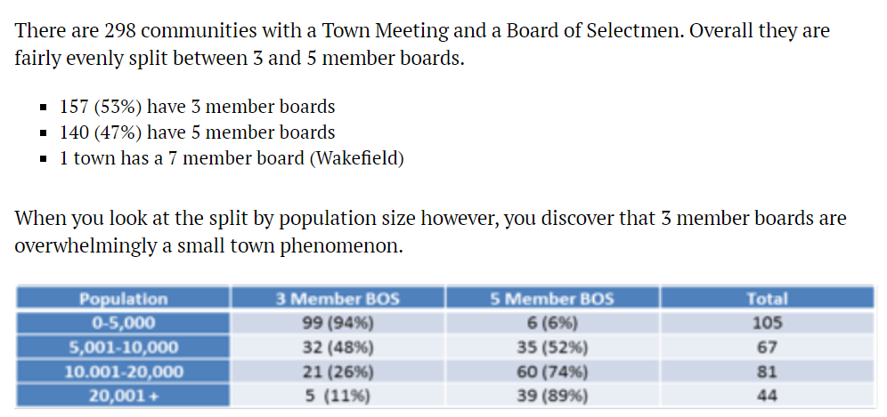
Milton, MA
https://www.miltonscene.com/2017/04/opinion-five-member-board-selectmen/

Slide 4
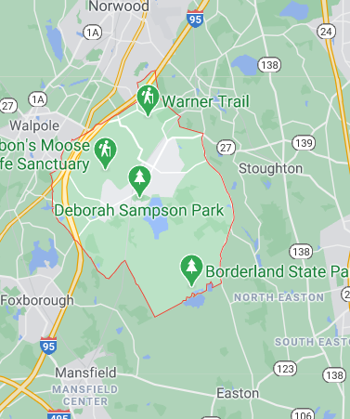
Surrounding Communities
All surrounding communities have 5 member boards
Norwood
Stoughton
Easton
Mansfield
Foxborough
Walpole

Slide 5
Reasons
Diversity
Time commitment
Ability to interact to with community and other committees
Open meeting law restrictions
Frequency of meetings

Slide 6
Questions

